Slide 1

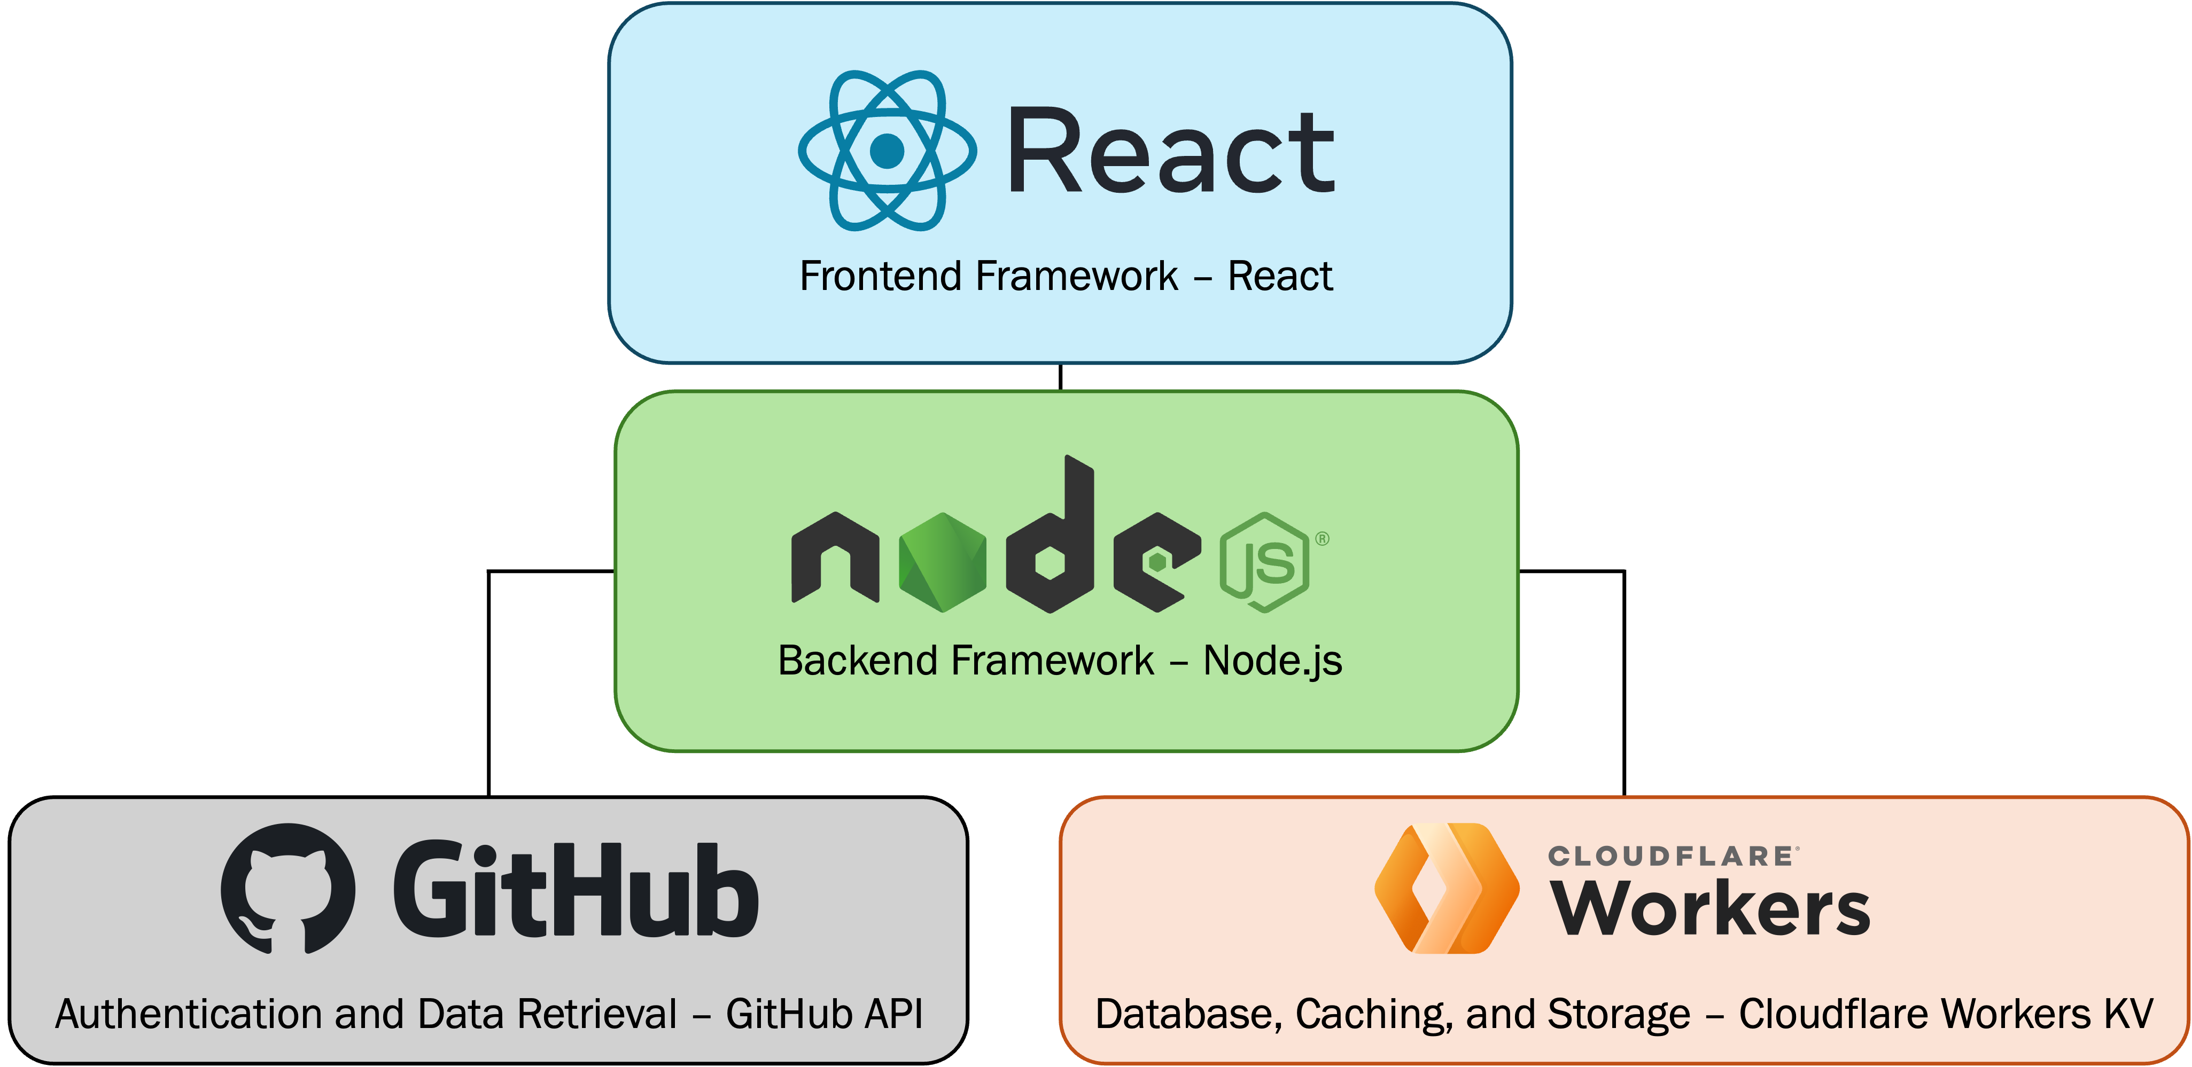
RepoInsight
Introduction
Features
Repolnsight is designed to provide software developers, team leads, and project managers with valuable insights into their collaborative work within GitHub repositories.
The primary objective is to empower users to visualize and assess their contributions over time, fostering a deeper understanding of both individual and team performance.
Target Users: Project Managers, team leads, software developers, etc.
Benefits: Provides a clearer understanding of individual and collective efforts, it supports a culture of accountability and continuous improvement in software projects.
Interactive charts that display an individual's contributions over time
Detailed statistics summarizing overall activity within a repository
Line modification tracker that shows the last person to modify each line in a specified file, helping users understand code ownership and history
Technologies

